Slide 1
CSE678 – Checkpoint presentation
Abhishek and Ananth (#6)
5/9/2012

Slide 2
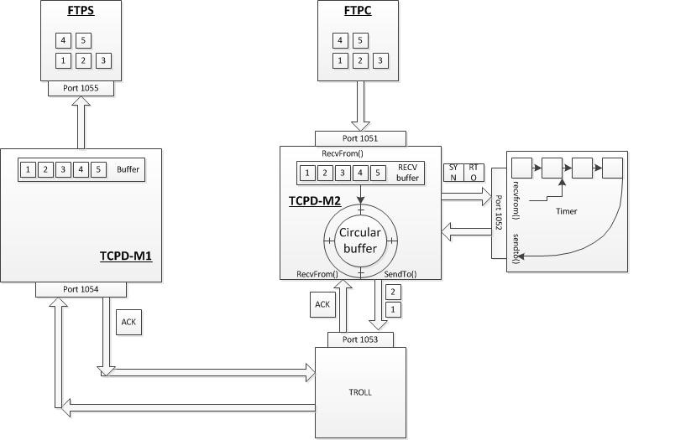
Architecture

Slide 3
Tasks completed
RTT/RTO computation
Checksum computation
Timer
Sliding window that sends 1 packet

Slide 4
Tasks yet to complete
Increase the sliding window to 20
Integrate RTO, checksum and the ACK from TCPD-client into the overall project

